Slide 1



How to survive the Holiday Season

Slide 2
How To Survive
the Holiday Season
Presented by Betty Huotari
Professional Organizer
www.LogicalPlacement.com
810-348-1772
betty@logicalplacement.com
Presentation available on my website until 10/31/24

Slide 3
Key Strategies
Discuss your calendar and upcoming events
Shop early
Keep track and plan ahead
Make a list and clutter-free gifts
Get help
Wrapping gifts
Don’t overdo it and be flexible
Plan ahead for next year

Slide 4
Discuss your calendar
Talk to family members on who is hosting the event
Talk to your partner about holiday parties at work
Talk to children about holiday parties at school
When are we decorating?

Slide 5
Shop Early
Have a clear plan.
Create a list of what you are going to buy for the person. Family members can provide suggestions.
Shop during off peak hours – try a weekday and perhaps even consider taking a day off of work.

Slide 6
Keep Track
Keep a holiday shopping file on family and friends.
Use paper or a file index with their information such as size and wish list or you can enter into contact on phone.
Set a budget and write down your purchases because it makes it easier to stick to your budget.

Slide 7
Plan Ahead
Call the store before you shop if you are looking for a specific item. Ask the store to set it aside.
Try reserving your holiday meal.
Group your errands so things run a little smoother and write things down. You will accomplish more in shorter time.

Slide 8

Toy Clear Out
Santa can’t bring more goodies unless there is ROOM for them. Use Thanksgiving break and the time between Thanksgiving and Christmas to go through the toy box.
If your child has out grown toys, donate them to a local charity.

Slide 9
Shopping on a budget
Economy-some people are scaling back
Pull names for adult family members and ask for a budget that everyone is comfortable with
Buy gifts for children only
Ask family members for gift ideas
Make gifts – but start early. People make candles, baked goods, jams etc…

Slide 10
Clutter-Free Gifts
Gift cards for gas, groceries, garden nurseries, restaurants, or coffee shops
Spa and pampering gifts
Gym or museum membership
Tickets to local symphony or Broadway show
Movie and a dinner
Lessons – music or golf
Open up a 529 for a grandchild – college savings plan
Think about a gift alternative - instead of giving each other gifts this year, each of you make a charitable donation – Hurricane Helene – redcross.org

Slide 11
Gift of Time
Join a friend: at an art class, yoga session, book/film club, scrapbooking class
Babysitting coupons
Take a child to lunch, on a day trip, to the museum/zoo, to a sport’s event
Coupon book: make a list of the things you know your partner would enjoy and include practical and fun things: for example do the dishes for a week, make a candlelight dinner, do grocery shopping, etc…

Slide 12

Get Help
Don’t be afraid of using outside help – be it a caterer, cleaning service, local bakery.
Delegate and assign tasks to other family members.
Consider hosting the event off-site then you won’t have to worry about getting your house in order
People can bring a dish or two

Slide 13
Wrapping Gifts
Place gifts together in a specific area. Don’t spread them throughout the house. Leave yourself hints if needed.
Create a wrapping station and keep all appropriate supplies on-hand.
Wrap your gifts as you bring them home and write them down in a book – depends on the age of the children.

Slide 14
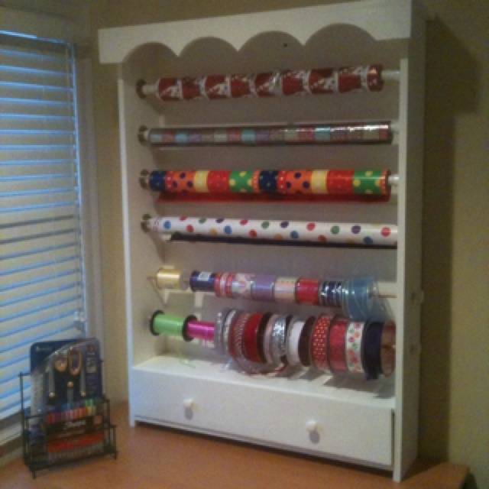

Gift Wrapping Station Ideas:

Slide 15
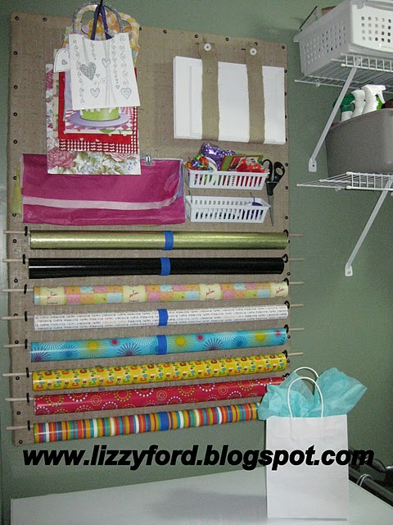
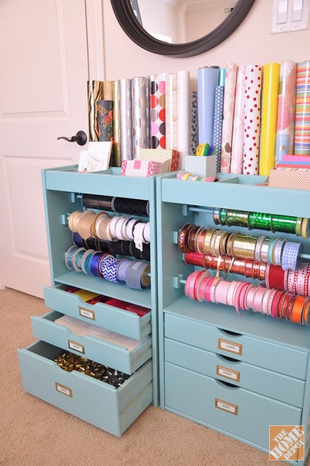

Slide 16
Organizing Solutions
Use clear or color to differentiate the holidays containers.
Label the contents and make sure the label is facing you when you store the containers.
Ask yourself, “When was the last time you used this?” If it is a family heirloom, then consider passing it down to the next generation.

Slide 17
Organizing Solutions
Ziploc bags for small items such as ornament hangers and anything small enough to get lost
Wreath boxes
Padded or quilted china keepers for your dishes
Before you put it away, ask yourself when was the last time you used it. Donate?

Slide 18
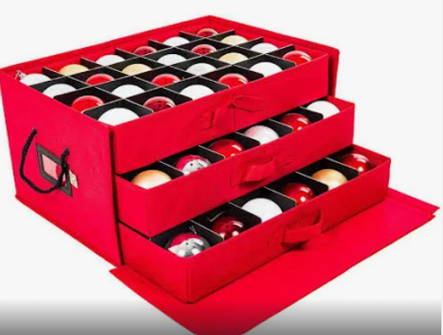
Bins with ornament dividers

Slide 19
Make time for joy
Slow down and build time to relax and enjoy the festive season into your schedule.
Have lunch with a friend.
Regain your balance and the true spirit of the season.

Slide 20
Out of town Guests
Prepare in advance and create a list of what needs to be done and work on it a day or so before they come.
Buy extra food and toiletries – have extra bottle water, snacks, etc…
Clean house and set up the guest room.
Have your laundry up to-date – towels/sheets.
Make plans for activities or see if they would like to do something special while they are in town.

Slide 21
Plan ahead for next year
Make a list of what items need replacing for the following year, and then you can go shopping after Christmas and save like scrooge.
Think about what worked and what needed to be improved on
Start a template/word document that you can use year to year and it acts as a checklist.
You can even put timeframes together so you break tasks down to make them manageable.

Slide 22
When you’re organized, you can:
Accomplish more at home
Meet important deadlines
Find things faster
Create and use streamlined processes
Keep clutter at bay
Get more enjoyment out of life

Slide 23


It will be here before we know it!

Slide 24
www.LogicalPlacement.com
Betty@LogicalPlacement.com
810-348-1772

